Slide 1
Chapter 1
Overview of
Electronic Commerce

Slide 2
Learning Objectives
Define electronic commerce (EC) and describe its various categories
Distinguish between electronic markets and interorganizational systems
Describe and discuss the content and framework of EC

Slide 3
Learning Objectives (cont.)
Understand the forces that drive the widespread use of EC
Describe the benefits of EC to organizations, consumers, and society
Describe the limitations of EC
Discuss some major managerial issues regarding EC

Slide 4
Opening Avenues:
Qantas Airways
Business-to-business (B2B) E-marketplace member
Business-to-customer (B2C): Online booking & wireless communications
Business-to-employee (B2E): Online training & banking

Slide 5

Qantas Airways (cont.)
Business-to-business (B2B)
  E-marketplace member
  Joined Airnew Co.—links major airlines with suppliers
    Fuel
    Fuel services
    Light maintenance services
    Catering

Slide 6

Qantas Airways (cont.)
Business-to-customer (B2C):
  Online booking
  Wireless communications

Slide 7

Qantas Airways (cont.)
Business-to-employee (B2E):
  Online training
  Online banking

Slide 8
Definitions
Business-to-business (B2B)
  Businesses make online transactions purchases with other business
Business-to-consumer (B2C)
  Online transactions between businesses and consumers
Business-to-employee (B2E)
  Information and services made available to employees online

Slide 9

Electronic Commerce Terms
E-business
EC defined from these perspectives
  Communications
  Business process
  Service
  Online
  Collaborations
  Community
EC

Slide 10
Electronic Commerce Terms (cont.)
Pure vs. Partial EC: based on the degree of digitization of
  Product
  Process
  Delivery agent
Traditional commerce: all dimensions are physical
Pure EC: all dimensions are digital
Partial EC: all other possibilities include a mix of digital and physical dimensions

Slide 11


Business Models
  A method of doing business by which a company can generate revenue to sustain itself.
    Examples:
      Name your price
      Find the best price
      Dynamic brokering
      Affiliate marketing

Slide 12
Business Models (cont.)
  Group purchasing
  Electronic tendering systems
  Online auctions
  Customization and personalization
  Electronic marketplaces and exchanges
  Supply chain improvers
  Collaborative commerce

Slide 13
Electronic Markets
(E-marketplaces or E-marketspaces)
A market is a network of interactions and relationships where information, products, services, and payments are exchanged.
  It handles all the necessary transactions
  It is a place where shoppers and sellers meet electronically
  Sellers and buyers negotiate, submit bids, agree on an order, and finish the execution on- or off-line

Slide 14
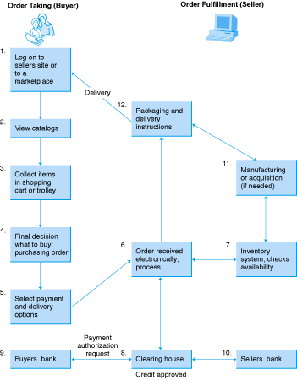
Figure 1-2
Transactions in Electronic Markets

Slide 15
Electronic Exchanges
Electronic exchanges provide dynamic pricing by matching real-time supply and demand
  Live auctions
  Stock exchanges

Slide 16
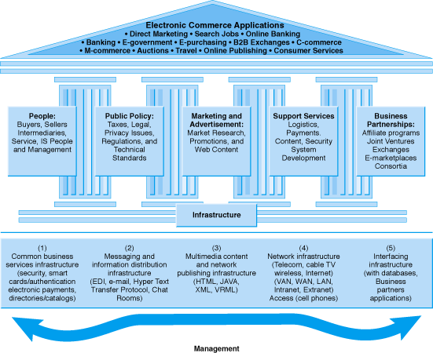
Figure 1-3 A Framework for Electronic Commerce

Slide 17
Electronic Commerce is Interdisciplinary
Marketing
Computer sciences
Consumer behavior and psychology
Finance
Economics
Management information systems
Accounting and auditing
Management
Business law and ethics
Others

Slide 18
The Driving Forces of
Electronic Commerce
The New World of Business
  Business pressures
  Organizational responses
  The role of Information Technology (including electronic commerce)

Slide 19
Major Business Pressures
Strong competition
Global economy
Regional trade agreements (e.g. NAFTA)
Extremely low labor cost in some countries
Frequent and significant changes in markets
Increased power of consumers
Market and
economic pressures

Slide 20
Major Business Pressures (cont.)
Changing nature of workforce
Government deregulation of banking and other services
Shrinking government subsidies
Increased importance of ethical and legal issues
Increased social responsibility of organizations
Rapid political changes
Societal and environmental pressures

Slide 21
Major Business Pressures (cont.)
Rapid technological obsolescence
Increase innovations and new technologies
Information overload
Rapid decline in technology cost vs. performance ratio
Technological pressures

Slide 22
Organizational Responses
Strategic systems
Continuous improvement efforts
Business process reengineering (BPR)
Business Alliances
Electronic commerce

Slide 23
Organizational Responses
External Environment, Social, Economic, Political, etc
Organization
Structure and the
Corporate Culture
The Organization’s
Strategy
Management
and
Business Process
Information
Technology
Individual
and Roles
Framework for Organizational and Societal Impacts of Information Technology

Slide 24
IT Support and EC
  Reducing cycle time and time to market
  Empowerment of employees and collaborative work
  Supply chain improvements
  Mass customization
  Change management

Slide 25
The Benefits of EC
Benefits to Organizations
  Expands the marketplace to national and international markets
  Decreases the cost of creating, processing, distributing, storing and retrieving paper-based information

Slide 26

Benefits of EC (cont.)
Benefits to Organizations (cont.)
  Allows reduced inventories and overhead by facilitating pull-type supply chain management
  The pull-type processing allows for customization of products and services which provides competitive advantage to its implementers

Slide 27
Benefits of EC (cont.)
Benefits to Organizations (cont.)
  Reduces the time between the outlay of capital and the receipt of products and services
  Supports business processes reengineering (BPR) efforts
  Lowers telecommunications cost - the Internet is much cheaper than value added networks (VANs)

Slide 28
Benefits of EC (cont.)
Benefits to consumers
  Enables consumers to shop or do other transactions 24 hours a day, all year round from almost any location
  Provides consumers with more choices
  Provides consumers with less expensive products and services by allowing them to shop in many places and conduct quick comparisons

Slide 29
Benefits of EC (cont.)
Benefits to consumers (cont.)
  Allows quick delivery of products and services (in some cases) especially with digitized products
  Consumers can receive relevant and detailed information in seconds, rather than in days or weeks
  Makes it possible to participate in virtual auctions

Slide 30
Benefits of EC (cont.)
Benefits to consumers (cont.)
  Allows consumers to interact with other consumers n electronic communities and exchange ideas as well as compare experiences
  Facilitates competition, which results in substantial discounts

Slide 31
Benefits of EC (cont.)
Benefits to society
  Enables more individuals to work at home, and to do less traveling for shopping, resulting in less traffic on the roads, and lower air pollution
  Allows some merchandise to be sold at lower prices benefiting less affluent people

Slide 32
Benefits of EC (cont.)
Benefits to society (cont.)
  Enables people in Third World countries and rural areas to enjoy products and services which otherwise are not available to them
  Facilitates delivery of public services at a reduced cost, increases effectiveness, and/or improves quality

Slide 33
The Limitations of EC
Technical limitations of electronic commerce
  Lack of sufficient system’s security, reliability, standards, and communication protocols
  Insufficient telecommunication bandwidth
  The software development tools are still evolving and changing rapidly

Slide 34
The Limitations of EC (cont.)
Technical Limitations of EC (cont.)
  Difficulties in integrating the Internet and electronic commerce software with some existing applications and databases
  The need for special Web servers and other infrastructures, in addition to the network servers (additional cost)

Slide 35
The Limitations of EC (cont.)
Technical Limitations of EC (cont.)
  Possible problems of interoperability, meaning that some EC software does not fit with some hardware, or is incompatible with some operating systems or other components

Slide 36
Non-Technical Limitations
Cost and justification
  The cost of developing an EC in house can be very high, and mistakes due to lack of experience may result in delays.
  There are many opportunities for outsourcing, but where and how to do it is not a simple issue
  In order to justify the system, one needs to deal with some intangible benefits which are difficult to quantify.

Slide 37
Non-Technical Limitations (cont.)
Security and Privacy
  These issues are especially important in the B2C area, but security concerns are not so serious from a technical standpoint
  Privacy measures are constantly improving too
  The EC industry has a very long and difficult task of convincing customers that online transactions and privacy are, in fact, very secure

Slide 38
Non-Technical Limitations (cont.)
Lack of trust and user resistance
  Customers do not trust:
    Unknown faceless sellers
    Paperless transactions
    Electronic money
  Switching from a physical to a virtual store may be difficult

Slide 39
Non-Technical Limitations (cont.)
  Other limiting factors are:
    Lack of touch and feel online
    Many unresolved legal issues
    Rapidly evolving and changing EC
    Lack of support services
    Insufficiently large enough number of sellers and buyers
    Breakdown of human relationships
    Expensive and/or inconvenient accessibility to the Internet

Slide 40
Putting It All Together
Major concern of today’s companies—how to transform themselves to take part in digital economy
Example:Toys, Inc.
  Uses intranet for internal communications, collaboration, dissemination of information
  Networked to e-marketspaces and large corporations
  Corporate portal for communication and collaboration with business partners

Slide 41
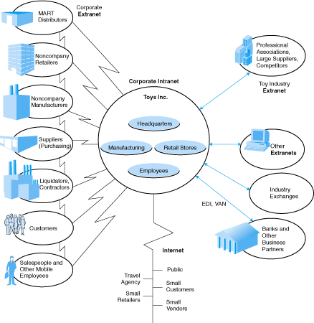
Figure 1-7
Putting It All Together
Prentice Hall, 2002

Slide 42
Managerial Issues
Is it real?
How to evaluate the magnitude of the business pressures.
What should be my company’s strategy towards EC?

Slide 43
Managerial Issues (cont.)
Why is the B2B area so attractive?
What is the best way to learn about EC?
What ethical issues exist?
How can failures be avoided?

Slide 44
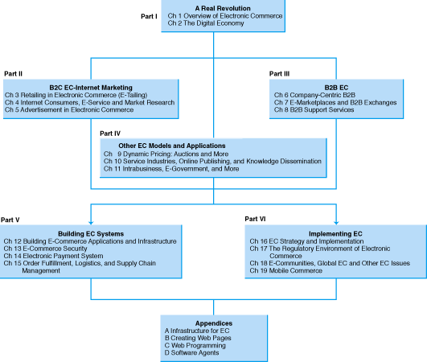
Figure 1-8
Plan of the Book
Prentice Hall, 2002

